Slide 1

EZ Ballot
Notes:
Looks great!

Slide 2
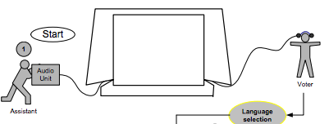
Problems
Difficulty in voting without assistance
Difficulty in setting up assistive devices (e.g., audio voting) by poll workers
Complexity of usage when added on AT to standard ballot (sighted voter 5 min. vs. non-sighted voter 31min.) (Piner & Byrne, 2011)
Notes:
Study shows that visually impaired voters took significantly longer to complete a ballot than sighted voters.
Whereas visual interfaces often consist of a non-linear organization of candidates (i.e., multiple columns of text that can be recognized by visual cues), auditory interfaces are presented sequentially in a linear process (i.e., each candidate’s name is heard one at a time). Thus, visually-impaired voters can become confused while navigating a ballot using audio (Burton & Uslan, 2002, 2004; Gilbert et al., 2010; Runyan, 2007; Runyan & Tobias, 2007).

Slide 3
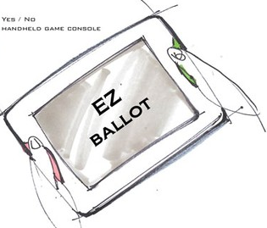
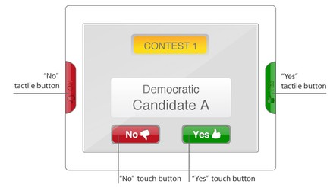
EZ Ballot (original)
Notes:
As we designed of linear structure there are more issues we found and have some alternatives to discuss with you.
let me show the demo first.
This is still working progress, but We can see interaction flow.

Slide 4
LIVE DEMO
Notes:
Working progress
Look and feel
Interaction flow
Not all the pages are linked.

Slide 5
The principles of Universal design
Equitable use
Flexibility in use
Simple and intuitive use
Perceptible information
Tolerance for error
Low physical effort
Size and space for approach & use
Notes:
The features of EZ Ballot have the UD principles as the underlying rationale for the design decision.
Universal Design
The design of products and environments to be usable by all people, to the greatest extent possible, without the need for adaptation or specialized design

Slide 6
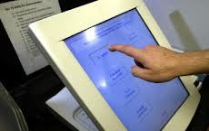
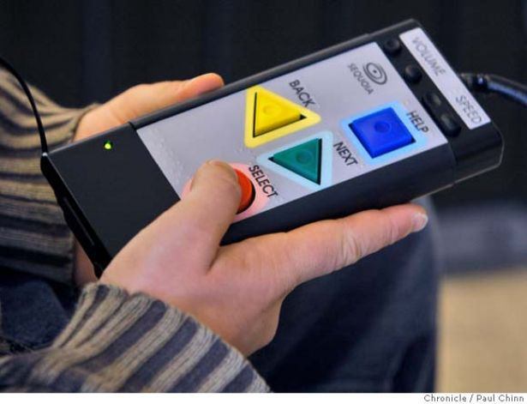
1. Equitable use
The design is useful and marketable to people with diverse abilities.
- Unified Universal EZ Ballot for everyone
Notes:
Provide same means of use for all users.
Automatic door is a great example of UD as providing all same equal access for everyone.
Current DRE machines yet segregating the users by providing special machine for certain users.
This is our goal of developing the EZ ballot to be usable by any users.
The EZ Ballot provides same means of use for sighted and non-sighted users.

Slide 7
2. Flexibility in use
The design accommodates a wide range of individual preferences and abilities.
Multimodal inputs
Visual and audio adjustable settings
Navigation between contests and candidates

Slide 8
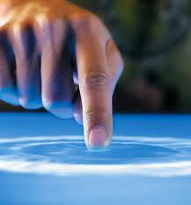
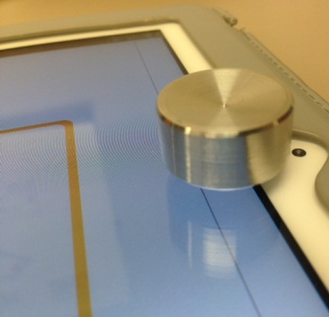
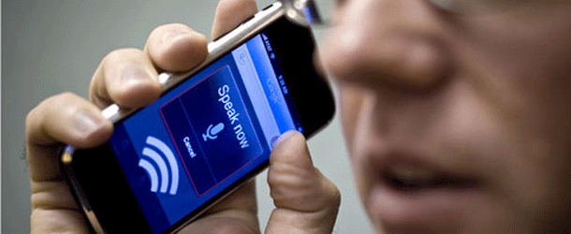

Multimodal inputs
Multimodal interfaces can improve accessibility for diverse users (Obrenovic, Abascal, & Starcevic, 2007; Tobias, 2003)
Touch input (Yes/No, browse contest & candidate)
Tactile button (Yes/No) – large push buttons with a concave surface
Speech input (Yes/No)
Gesture input (browse contest & candidate/ magnification)
Notes:
Provide choices in methods of use.
multimodal interfaces that combine human natural input modalities such as speech, touch, and gestures (Obrenovic et al., 2007; Tobias, 2003).
Touch input is for sighted users.
Tactile button can be useful for visually impaired users
Speech input also can be useful for visually impaired users .. Protect privacy.
We might also include head gesture that can be node (yes) and left and right (no)

Slide 9
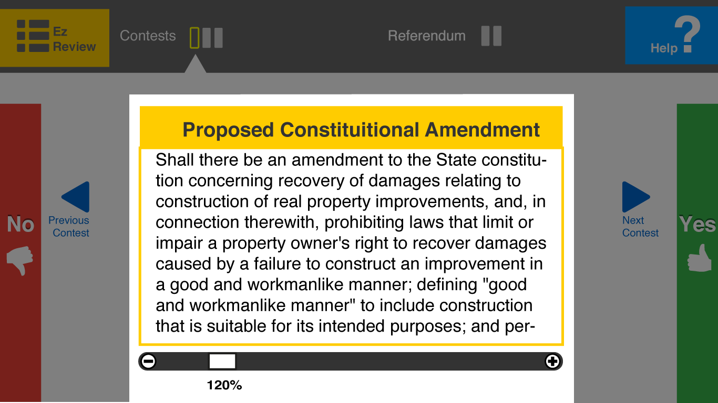
Visual and Audio adjustable settings
Ability to change text size/ reverse colors
Ability to change voice speed
Demo
Notes:
Provide choice in methods of use.
Visual and audio custom settings are very important feature for visually-impaired users and also older adults.
Several current DREs offer a visual interface with magnification options, but they are very limited.
AutoMARK provides only two magnification levels of 8.5- and 17-point font size, normal and twice the normal size.
However, some low-vision voters needed magnification to 24 points or even 34 points (four times the normal) (Runyan, 2007).

Slide 10
Discussion 1. Navigation alternatives
Contest 1
Contest 2
Contest 3
Ref. 1
Ref. 2
Candidate 1
Candidate 2
Candidate 3
Candidate 4

Slide 11
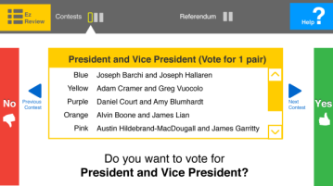
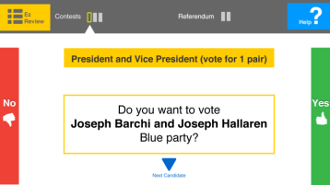
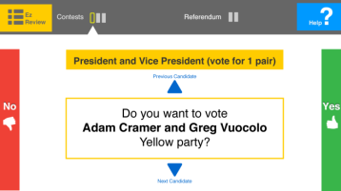
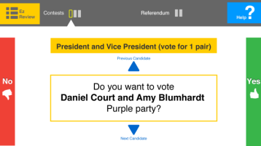
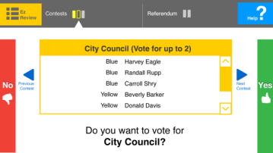
Discussion 1. Navigation alternative A
Contest 1
Candidate 1
Candidate 2
Candidate 3
Contest 2
Linear horizontal movement
Be able to move freely between contests and candidates
Matches to the linear structure (easy to link to a cognitive map)
Requires more steps to go through all the pages
Notes:
Provide choice in methods of use.
The way exit the sequencing flow, The ballot provides the way to navigate between contests and candidates without making a decision on each page.
The user can navigate pages by clicking visual arrows or by using finger swiping gestures.
For a distinguishable mapping structure of the contest and candidates, navigation between contests requires left and right swiping gestures.

Slide 12



Discussion 1. Navigation alternative b
Linear vertical movement
Be able to move freely between contests and candidates
Requires more steps to go through all the pages
Contest 1
Candidate 1
Candidate 2
Candidate 3
Candidate 6
Notes:
navigation between candidates requires up and down swiping gestures
Trade-off
Providing browsing between contest and candidate gives a litte more flexibility, but
Cognitively more challenging.

Slide 13
Discussion 1. Navigation alternative c
Contest 1
Contest 2
Contest 3
Candidate 1
Mixed horizontal and vertical movement.
Be able to move only between contests
Be able to move only between candidates
Requires less steps
Limited flexibility (e.g., can’t go back from candidate to contest)
Might confuse users’ mind mapping having different directions (learning curve)
Candidate 2
Candidate 3
Candidate 6
Notes:
Provide choice in methods of use.
The way exit the sequencing flow, The ballot provides the way to navigate between contests and candidates without making a decision on each page.
The user can navigate pages by clicking visual arrows or by using finger swiping gestures.
For a distinguishable mapping structure of the contest and candidates, navigation between contests requires left and right swiping gestures.

Slide 14
Discussion 1. Navigation alternative d
Contest 1
Contest 2
Contest 3
Candidate 1
Candidate 2
Mixed horizontal and vertical movement.
Be able to move between contests and candidates
Requires less steps
Flexibility (e.g., can go back from candidate to contest)
Might confuse users’ mind mapping having different directions (learning curve)
Candidate 3
Candidate 6
Notes:
Provide choice in methods of use.
The way exit the sequencing flow, The ballot provides the way to navigate between contests and candidates without making a decision on each page.
The user can navigate pages by clicking visual arrows or by using finger swiping gestures.
For a distinguishable mapping structure of the contest and candidates, navigation between contests requires left and right swiping gestures.

Slide 15
3. Simple and intuitive use
Use of the design is easy to understand, regardless of the user’s experience, knowledge, language skills, or current concentration level.
Linear structure
Consistent response structure throughout (Yes/no questions)

Slide 16
Linear structure
Follow a particular sequence of steps by responding to single yes and no questions.
Linear structure vs. Hierarchical structure (Chaudry, Connelly, Siek, & Welch, 2012; Parikh, Ghosh, & Chavan, 2003)
Focused attention. “stay focused only on particular task” (A blind user)
Cons: a single question on one page requires many number of pages, resulting in repetitive actions.
Contest 1
Candidate 1
Candidate 2
Contest 2
Cast
Notes:
The EZ Ballot has a linear structure that provides two main advantages: a directed guide and a matched audio interface.
a directed guide that allows users to follow a particular sequence of steps. By following the sequence, the users can easily manage the focus.
Studies (Chaudry, Connelly, Siek, & Welch, 2012; Parikh, Ghosh, & Chavan, 2003) have suggested a linear structure rather than a hierarchical information structure for low-literacy or novice users (who can be majority of voters) because they lose focus while navigating.
In addition, the nature of the linear structure resembles that of the linear audio interface, from which users who are visually impaired or reading disabled can benefit. Thus, the visual structure of the EZ Ballot can easily be linked with the audio interface, providing equal access to both sighted and non-sighted users.

Slide 17
Consistent Response Structure
Simplicity
Easy to understand
“It is easy to understand since it just need me to answer simple yes no questions” (A English-as-second-language speaker)
“the confirmation key on the majority of our assistive technology devices utilizes the confirmation key on the right!” (A blind user)
“simple structure, but not clear for the next direction after clicking “no” (A dexterity user)
“It would be better if I could go back” (A English-as-second-language speaker)

Slide 18

Discussion 2. Yes no instruction alternatives
Notes:
What’s your expectation when you press Yes
What’s your expectation when you press No

Slide 19
Discussion 2. Yes no instruction alternative a
Add explicit instruction for “Yes” and “No”
(e.g., press “Yes” to vote president and vice president.
Press “No” to go to next contest)
- May provide too much information on the screen

Slide 20
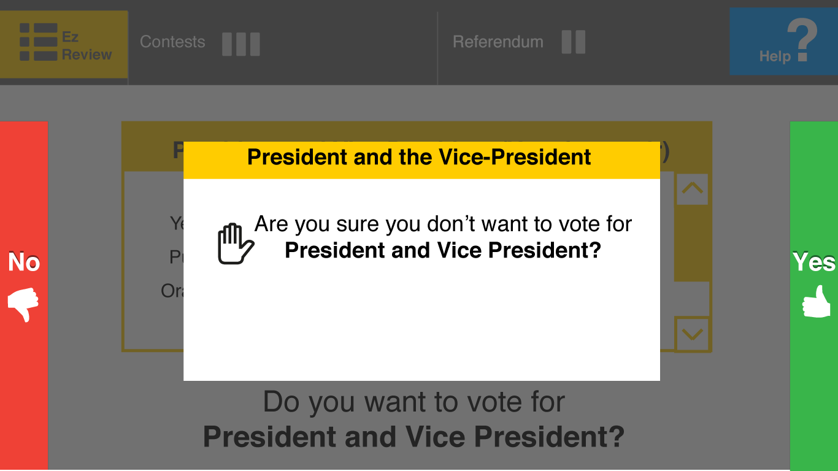
Discussion 2. Yes no instruction alternative b
Add prompt when press “No”
Confirmation of non-error
Ambiguous meaning of “not voting this contest”
2a. Abstain (no vote)
2b. skip over (may come back)
Notes:
Are you sure you don’t want to vote for president and vice president?

Slide 21
Discussion 2. Yes no instruction alternative B
Wording
Explicit questions When press “No”
“Do you want to skip over this contest and return to it later?”
“Do you want to abstain this contest?”
Notes:
Does it need to be explicit?

Slide 22
4. Perceptible information
The design communicates necessary information effectively to the user, regardless of ambient conditions or the user’s sensory abilities.
Visibility of information
Redundant cues (simultaneous visual and audio interface)

Slide 23
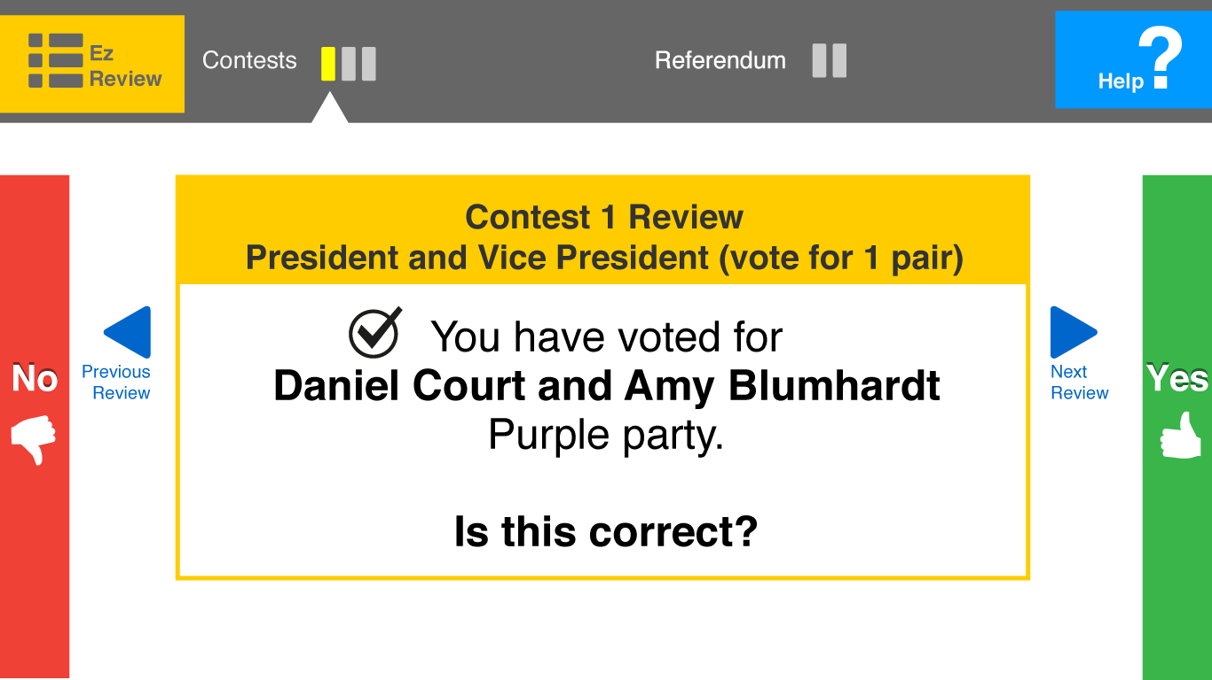
Visibility of information
Large text size
High contrast between foreground and background
Information is prioritized by importance (boldface)
Color conventions (green for yes, red for no)
Notes:
Large text and high contrast color

Slide 24
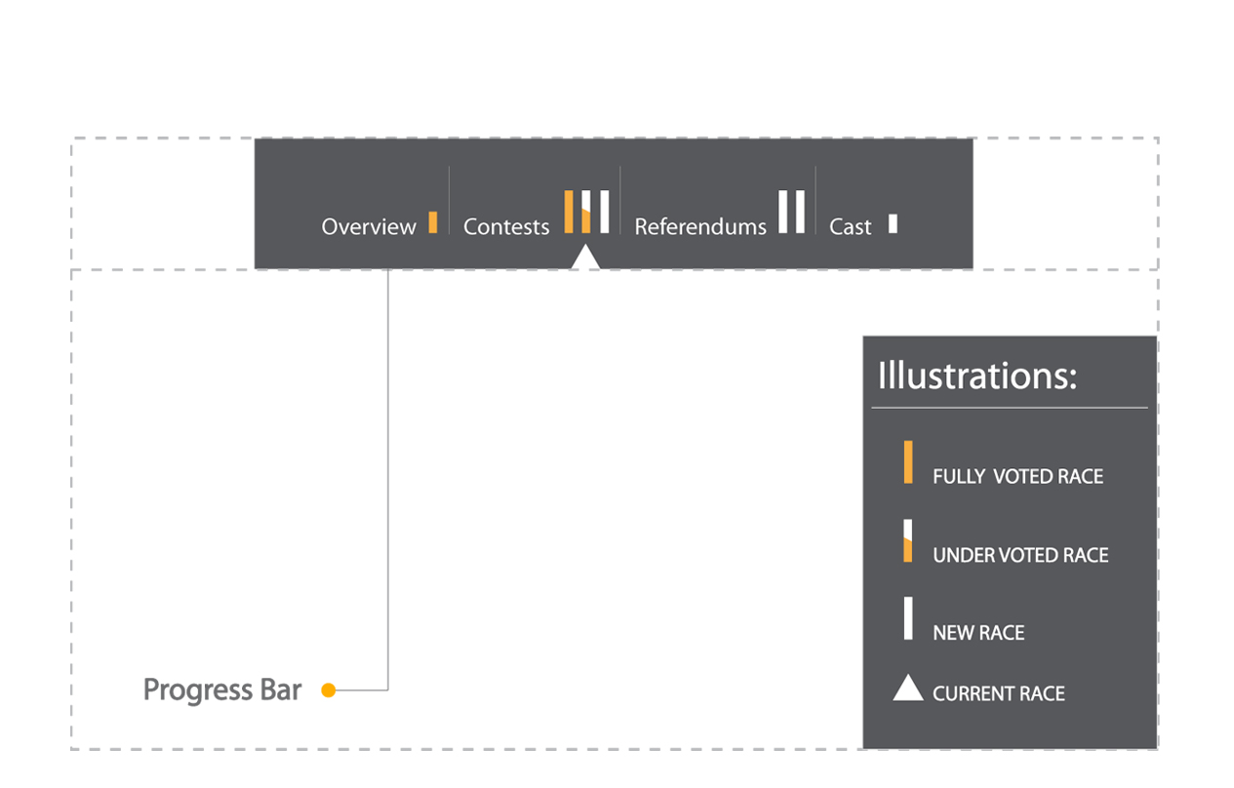
Discussion 3. progress bar alternatives
Progress bar : Informative / Scrollable / Clickable

Slide 25
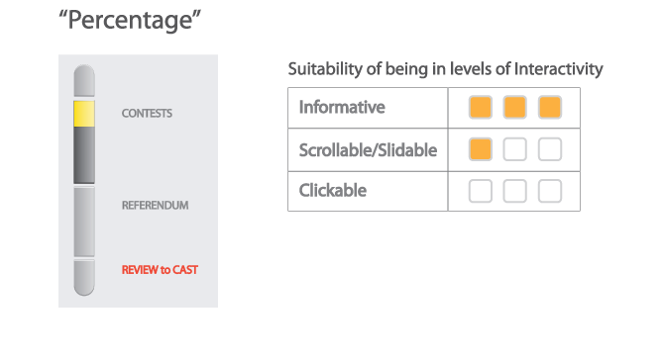
Discussion 3. progress bar alternative a

Slide 26
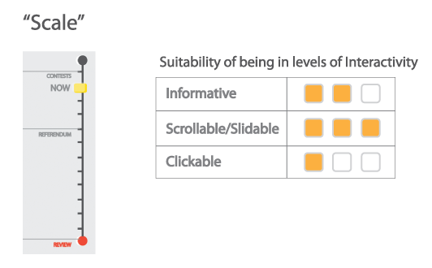
Discussion 3. progress bar alternative b

Slide 27
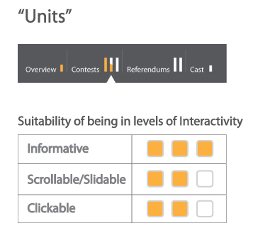
Discussion 3. progress bar alternative C

Slide 28
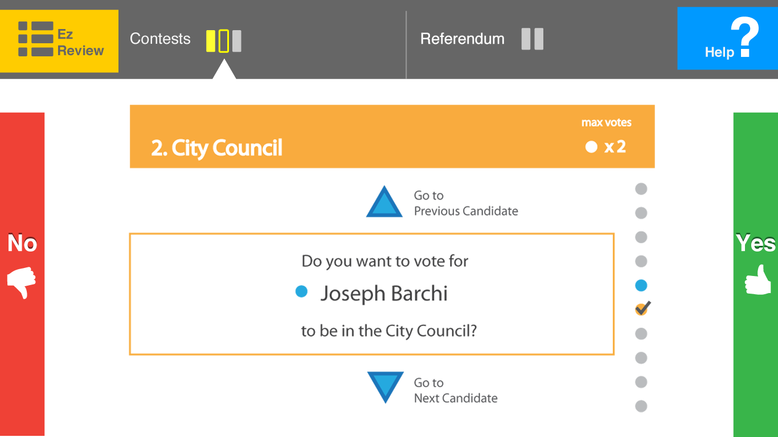
Discussion 4. Candidates list alternatives

Slide 29
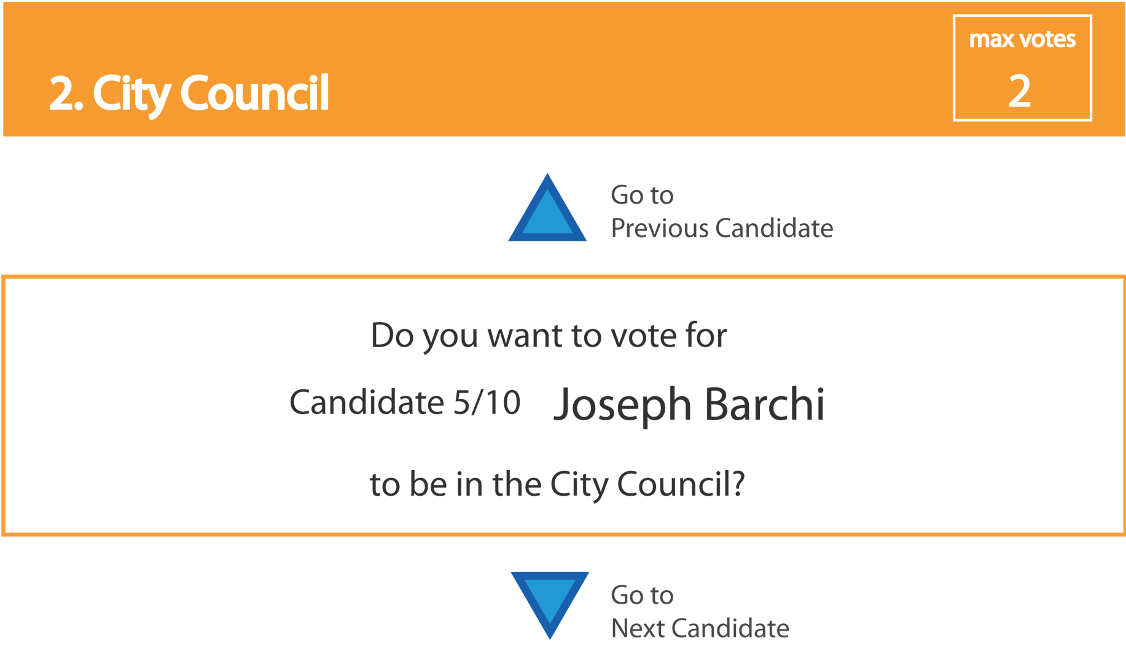
Discussion 4. Candidates list alternative a
Text (maximum votes ) + Text

Slide 30
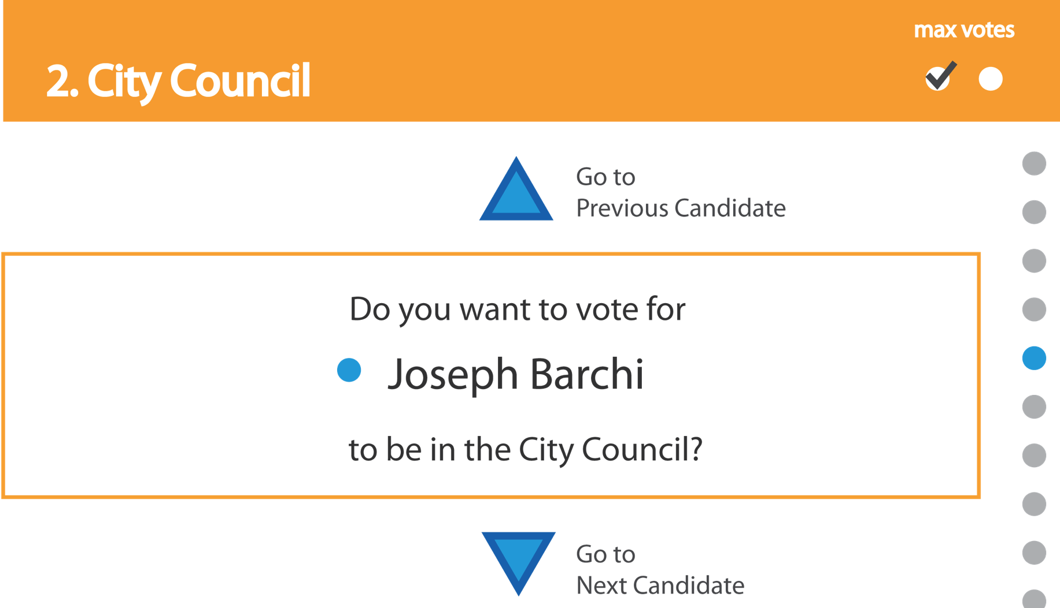
Discussion 4. Candidates list alternative b
Graphic (maximum votes ) + graphic

Slide 31
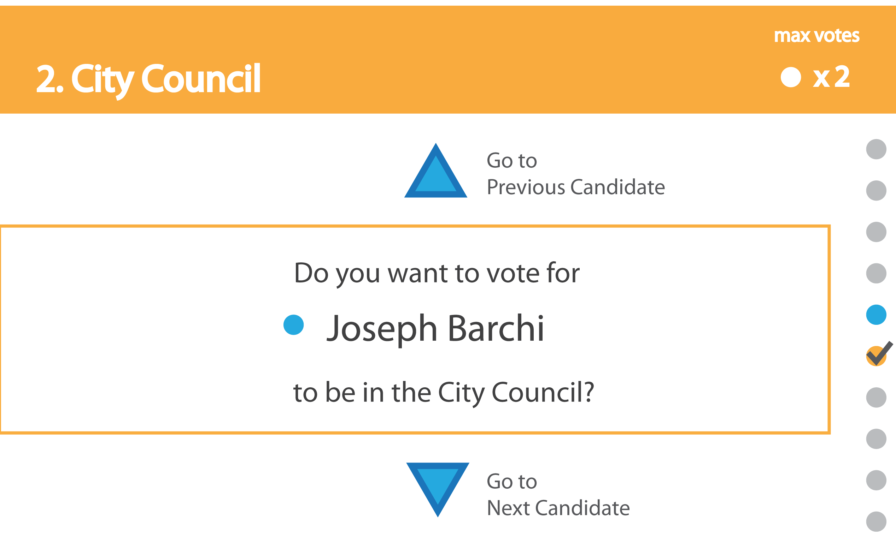
Discussion 4. Candidates list alternative c
Text (maximum votes ) + graphic

Slide 32
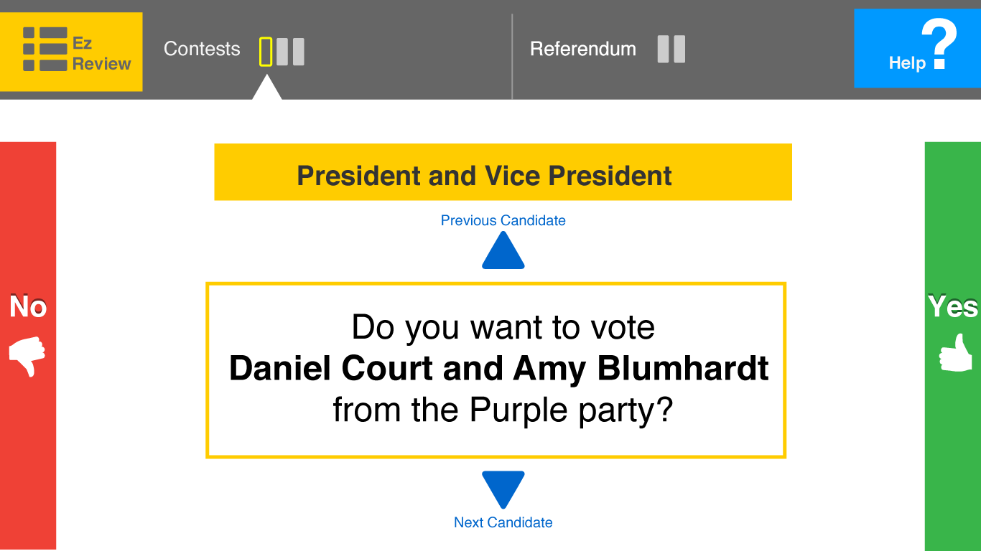

Redundant cues
Simultaneous visual display and audio of screen content.
Many low-vision users complain about the lack of simultaneous visual and audio interface (Burton & Uslan, 2002; Pierce, 2005; Runyan & Tobias, 2007)
Notes:
The EZ Ballot is integrated simultaneous visual and audio interface, rather than having either visual or audio interface that many current DREs offer.

Slide 33
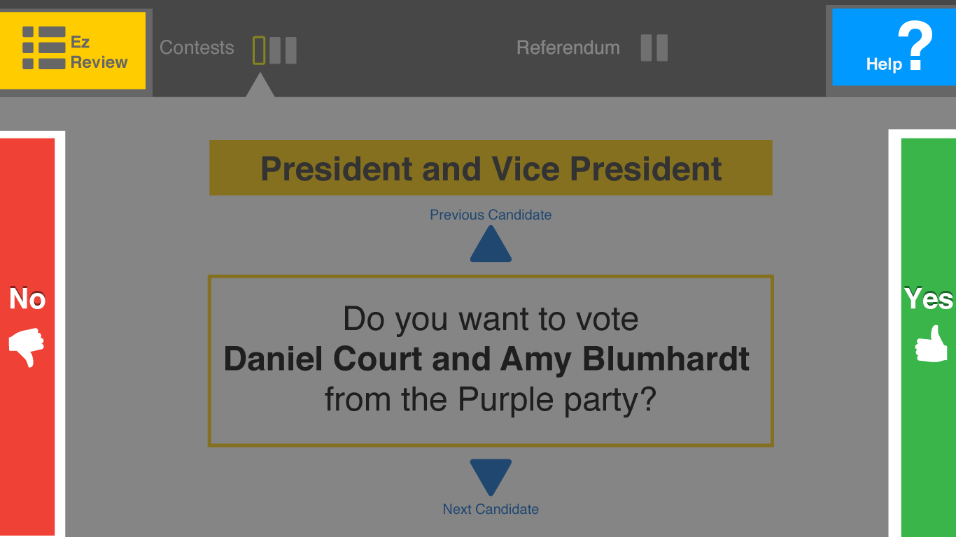
Redundant cues
Redundant cues for the buttons (color, text, icon, and sound)
Speech sound (e.g., “EZ Review”, “Help”) is added to indicate that an action has occurred.
Notes:
We used redundant cues for the buttons using color, text, icon, and sound.
Because green and red are internationally recognizable, they represented “yes” and “no.”
However, since red and green are indistinguishable to individuals who are color blind, the buttons are differentiated by text and symbols.

Slide 34
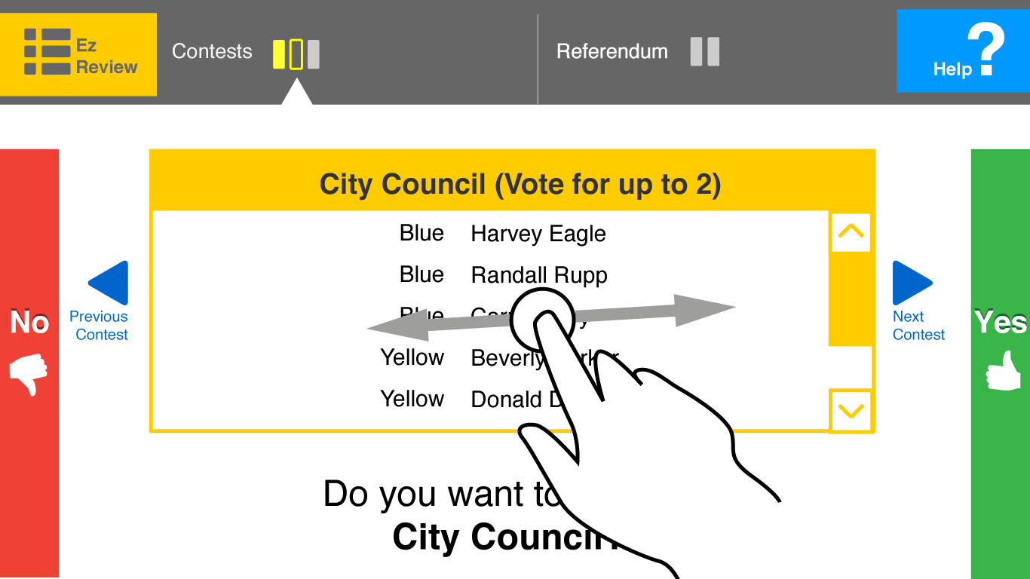
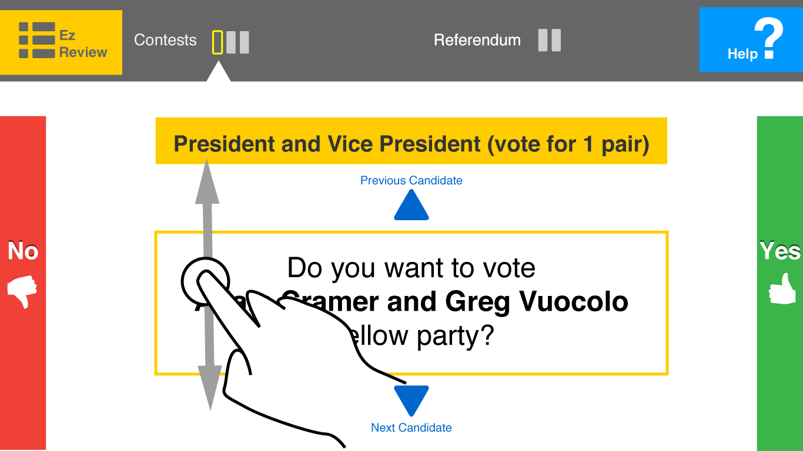
Redundant cues
Redundant cues for the navigation (icon, text, finger gesture)
Notes:
We used redundant cues for the buttons color, text, icon, and sound.

Slide 35
Discussion 5. EZ write-in alternatives
Slider Type
Spinner Type

Slide 36
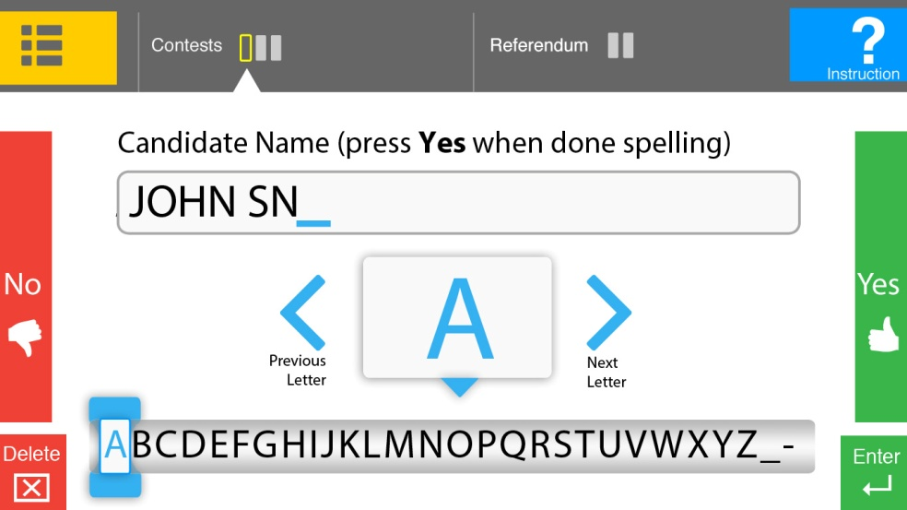
Discussion 5. ez write-in alternative A: Slider
PROs: Showing the whole alphabet ; Provide random access to the letters
CONs: Need more refined motor control; Need to move finger across the bottom of the screen

Slide 37
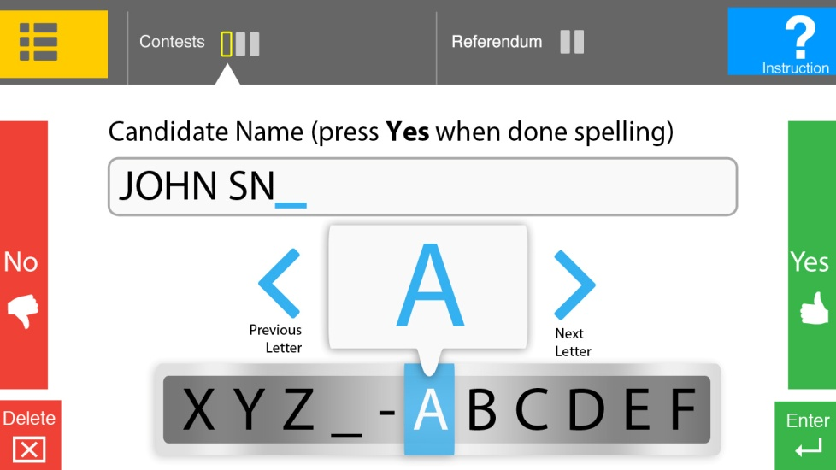
Discussion 5. ez write-in alternative B: spinner
PROs: Require less refined motor control; User’s finger could stay in one place.
CONs: Could be confusing for people who haven’t used a spinner before.

Slide 38
5. Tolerance for error
The design minimizes hazards and the adverse consequences of accidental or unintended actions.
Prompts
Sub-review
Contest 1
Overview
Candidate 1
Prompt
Sub-review
Contest 2
overview
Cast
No
No

Slide 39
Write-in flow
Contest n Overview
Contest n Sub-review
……
Write-In Candidate?
Yes
Typing
Interface
Yes
Yes
Confirm
Prompt
No
No

Slide 40
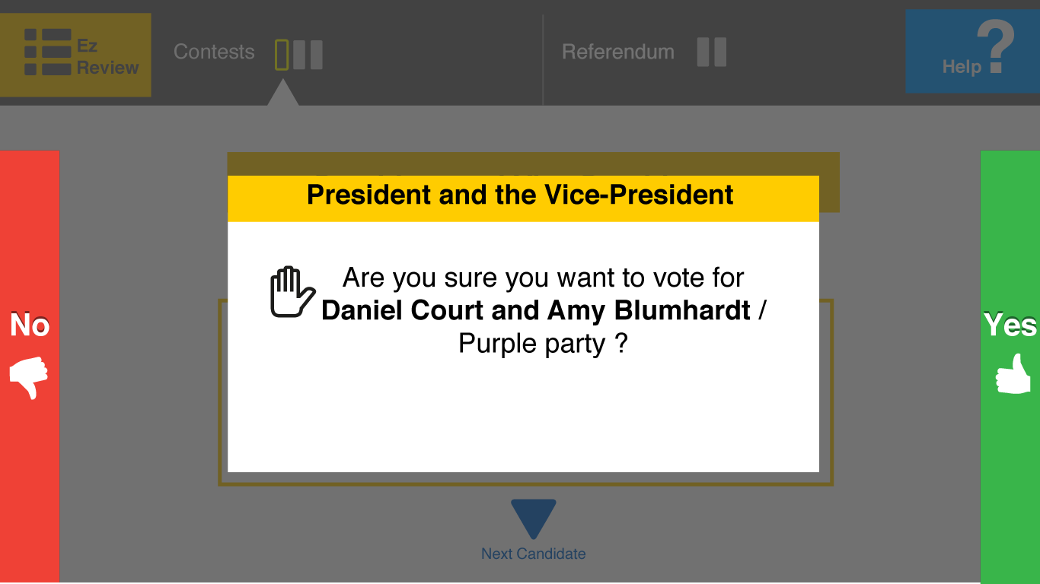
Prompts
Helps to confirm the selection or detect mistakes
Notes:
Prompt is for confirming the selection or detect mistakes

Slide 41
Sub-review
Notes:
This is contest 3. voted a candidate for county commissioner. Attempt to click “EZ Review”
What’s your expectation when you press “EZ Review” button?

Slide 42
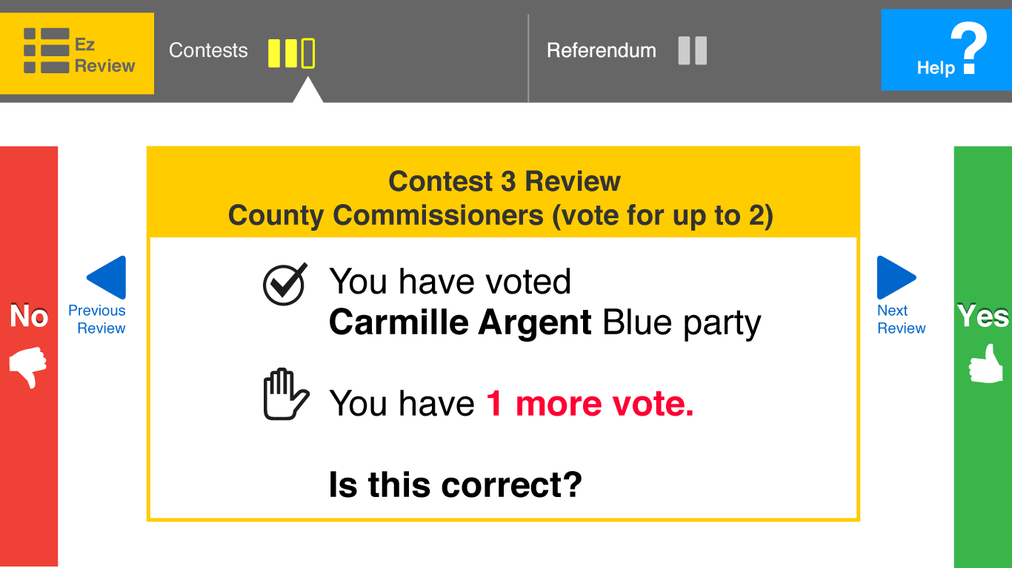
Sub-review
Notes:
Helps to confirm the maximum number of votes.

Slide 43
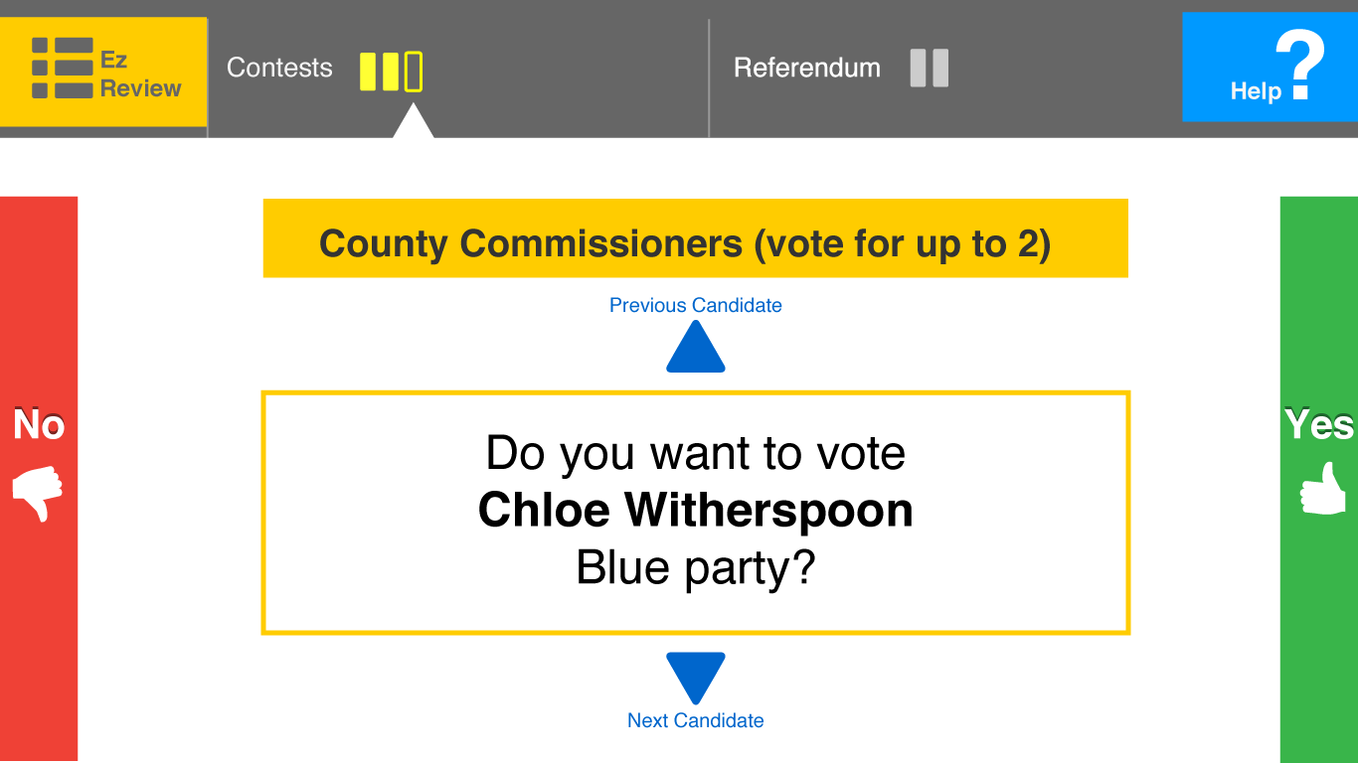
Discussion 6. review button alternatives
Notes:
This is contest 3. voted a candidate for county commissioner. Attempt to click “EZ Review”
What’s your expectation when you press “EZ Review” button?

Slide 44
Discussion 6. review button alternative A : current
PROs: Fast way to review the current contest; Fast way to change the vote
CONs: No overview of the review

Slide 45
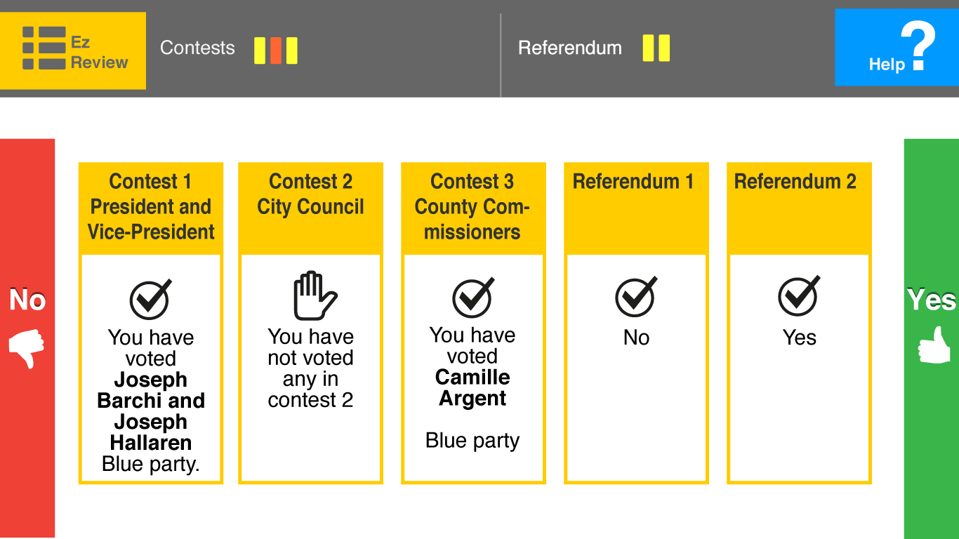
Discussion 6. review button alternative B : overview
PROs: provides the big picture overview of contests with reviews
CONs: cannot fit all reviews in one page if the contest is longer; requires more steps when changing a vote.

Slide 46
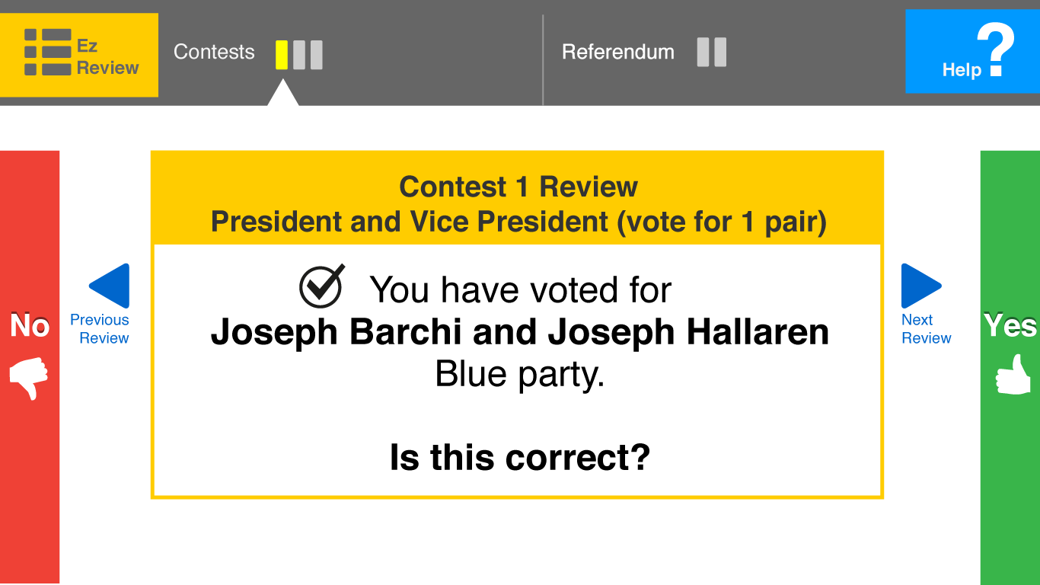
Discussion 6. review button alternative c : first
PROs: Allows to review from the first contest.
CONs: No overview of the review, requires more steps to review the latest contest

Slide 47
Discussion 7. help button alternatives
Notes:
What’s your expectation when you press “Help” button?

Slide 48
Discussion 7. help button alternative A
Directly go to instruction page
Notes:
This is contest 3. voted a candidate for county commissioner. Attempt to click “EZ Review”
What’s your expectation when you press “EZ Review” button?

Slide 49
Discussion 7. help button alternative B
Provide options to choose what help is needed.
“Do you want to go to instruction page?”
“Do you need any personal assistance?”

Slide 50
6. Low physical effort
The design can be used efficiently and comfortably and with a minimum fatigue.
Mobile tablet
Touch and speech input

Slide 51
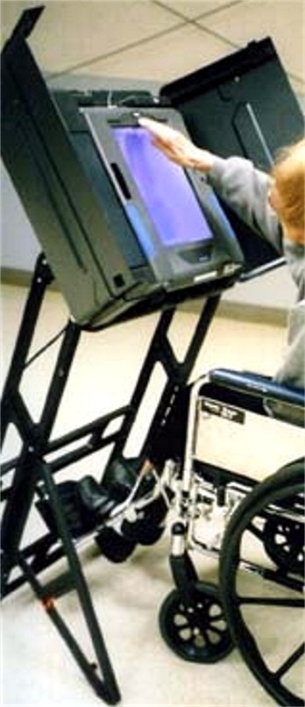
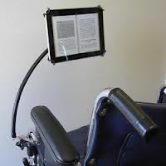
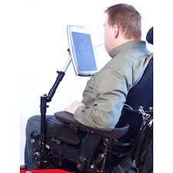
Mobile tablet
Allow user to maintain a neutral body position
Minimize sustained physical effort

Slide 52
Multimodal inputs
Touch input (Yes/No, browse contest & candidate)
Speech input (Yes/No)
Minimize sustained physical effort
Notes:
Provide choices in methods of use.
multimodal interfaces that combine human natural input modalities such as speech, touch, and gestures (Obrenovic et al., 2007; Tobias, 2003).
Touch input is for sighted users.
Tactile button can be useful for visually impaired users
Speech input also can be useful for visually impaired users .. Protect privacy.
We might also include head gesture that can be node (yes) and left and right (no)

Slide 53
7. Size and space for approach & use
Appropriate size and space is provided for approach, reach, manipulation, and use regardless of user’s body size, posture, or mobility.
- Size and location of buttons

Slide 54
Size & Location of buttons
Size of buttons : minimum 19.05mm (Jin, ZhaoXia, Plocher, Tom, & Kiff, Liana, 2007).
Location of buttons: (João Oliveira, Tiago Guerreiro, Hugo Nicolau, Joaquim Jorge, and Daniel Gonçalves, 2011)
,
Notes:
Older adults with poor manual dexterity – larger button size at least 19.05mm and a larger spacing, 6.35mm to 12.7 mm is required.
)
the buttons are located on the corner or the edge of the screen so that blind or visually-impaired users can easily locate them using audio instruction.
Write-in page has delete and enter key are located on the bottom of the screen.

Slide 55
Formative Evaluation Plan
Observation and qualitative feedback from the diverse group of users with and without functional limitations (e.g., Visual, mobility/dexterity, and minor cognitive impairments)
Pre-survey (demographic, voting, technology experience)
Voting tasks with “Think aloud” method
Post-trial survey (semi-structured interview)
Notes:
The observers will take notes the following:
Do participants hold the tablet or put it on the table while performing tasks?
How do participants’ posture change during tasks?
What types of errors occur during the tasks?
What inputs do participants use often? Do they change the use of inputs during tasks?
How often do participants use gesture input (swiping gesture)? How well do they use gesture inputs?
Are participants frustrated or confused by any interaction?
How many times do participants need assistance?

Slide 56
references
Burton, D. and Uslan, M. (2002). Cast a Vote by Yourself: A Review of Accessible Voting Machines. Access World, 3, 6.
Chaudry, B. M., Connelly, K. H., Siek, K. A., & Welch, J. L. (2012). Mobile interface design for low-literacy populations. Paper presented at the Proceedings of the 2nd ACM SIGHIT International Health Informatics Symposium, Miami, Florida, USA.
Jin, ZhaoXia, Plocher, Tom, & Kiff, Liana. (2007). Touch Screen User Interfaces for Older Adults: Button Size and Spacing. In C. Stephanidis (Ed.), Universal Acess in Human Computer Interaction. Coping with Diversity (Vol. 4554, pp. 933-941): Springer Berlin Heidelberg.
João Oliveira, Tiago Guerreiro, Hugo Nicolau, Joaquim Jorge, and Daniel Gonçalves. (2011). Blind people and mobile touch-based text-entry: acknowledging the need for different flavors. In The proceedings of the 13th international ACM SIGACCESS conference on Computers and accessibility (ASSETS '11). ACM, New York, NY, USA, 179-186.

Slide 57
references
Obrenovic, Zeljko, Abascal, Julio, & Starcevic, Dusan. (2007). Universal accessibility as a multimodal design issue. Commun. ACM, 50(5), 83-88. doi: 10.1145/1230819.1241668
Parikh, T., Ghosh, K., & Chavan, A. (2003). Design studies for a financial management system for micro-credit groups in rural india. Paper presented at the Proceedings of the 2003 conference on Universal usability, Vancouver, British Columbia, Canada.
Pierce, K. (2005). Accessibility Analysis of Four Proposed Voting Machines.
Piner, G. E. and Byrne, M. D. (2011).The Experience of Accessible Voting. Proceedings of the Human Factors and Ergonomics Society Annual Meeting, 55, 1,1686-1690.
Runyan, N. and Tobias, J. (2007). Accessibility Review Report for California Top-to-Bottom Voting Systems Review.
Tobias, Jim. (2003). Information Technology and Universal Design: An Agenda for Accessible Technology. Journal of Visual Impairment & Blindness, 97(10), 592-601.

Slide 58
Thank you

Slide 59
Questions? Comments?

Slide 60
Extra slides

Slide 61
Discussion navigation & orientation
EZ Ballot (linear)
Direct selection (Non-linear)
EZ Ballot + Direct selection

Slide 62

Discussion navigation & orientation
EZ Ballot (linear)
PROs:
Step-by-step guidance
Consistent control mechanism (yes/no)
CONs:
Limited way to navigate through the ballot
When browsing pages, the process might get confused for some users.
Unpredictable actions (when press no)
Require repetitive actions

Slide 63
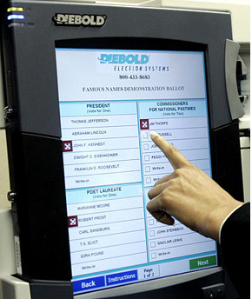
Discussion navigation & orientation
Direct selection (Non-linear)
PROs:
Easy to select candidates for sighted users
More information in one page
CONs:
Less focused
Does not work well with linear structure of audio voting

Slide 64
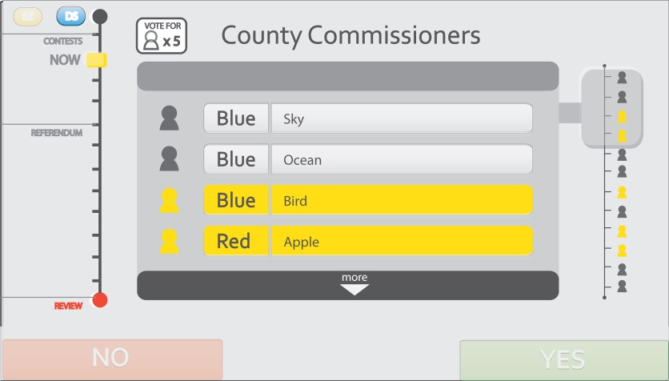
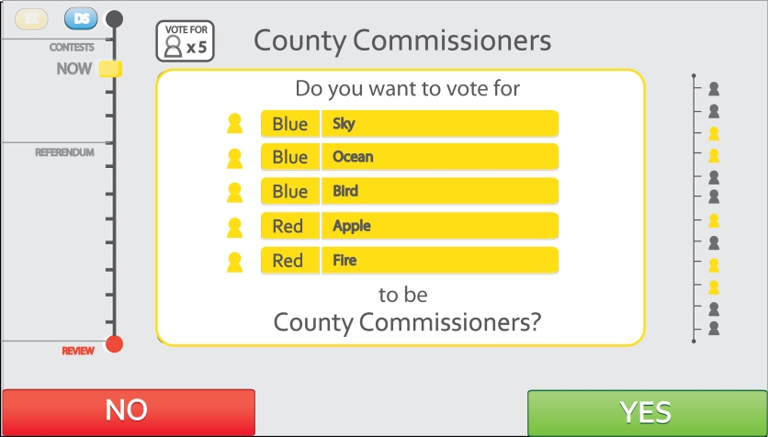
Discussion navigation & orientation
EZ Ballot + Direct selection
PROs: Better navigation and orientation; guidance; simple control mechanism; error proof
CONs: Hard to instruct users to change modes

Slide 65
wording
Contest 1
overview
Candidate 1
Prompt
Sub-review
Contest 2
overview
Cast
No
No
Are you sure you want to vote for Candidate 1?
You have voted for Candidate 1.
Is this correct?
Do you want to vote for Candidate 1?
You have voted for Candidate 1.
Do you want to change your vote?
Notes:
Prompt: Are you sure you want to vote for…? Yes -> go to sub-review page No -> go back to current page
Sub-review: You have voted “……” Is this correct? Yes -> go to next contest No >

Slide 66
Design criteria
Be usable by all voters with minimal or no training
Easy to use by all voters and poll workers
Be able to move freely from contest to contest
Be informed of the total number of contests
Be informed of the total number of candidates and the maximum number of candidates to vote
Be able to skip to another contest or “under vote” the contest
Notes:
Need to edit this page!!

Slide 67
Pilot Study: like
Simplicity of the yes and no structure
Easily focused
Exact choice
“It limits the amount of extraneous information that allows the user to stay focused only on that particular task” (A blind user)
“By requiring the person to confirm that they actually did make that “exact” choice” (A blind user)
“It is easy to understand since it just need me to answer simple yes no questions” (A English-as-second-language speaker)
Notes:
the ability to make an error is therefore significantly reduced.

Slide 68
Pilot Study: dislike
Unclear function of yes and no
Lack of going back
“Yes/No Buttons are not obvious to link with the questions” (A English-as-second-language speaker)
“simple structure, but not clear for the next direction after clicking “no” (A dexterity user)
Suggestions
“It would be better if I could go back”
“Provide explanation “yes” to go where and “no” to go where”

Slide 69
characteristics of EZ Ballot
Directed guide by presenting single yes/no question
Multimodal inputs (tactile, touch, speech)
Simultaneous visual and audio interface
Visual hierarchy by importance
Sufficient custom settings
Redundant cues of the buttons (color, text, icon, sound)
Prompt message
Navigation between contests and candidates
Informative progress bar
Visual cues of candidate’s list

